Slide 1


Web Development Project
https://anikateagrawal.github.io/WebBootcamp1.0-main/pages/Project.html

Slide 2
Languages
HTML-> The Hypertext markup language which is used for creating web pages and web applications.
CSS-> Cascading Style Sheets is a style sheet language which is used to describe the look and formatting of a document written in markup language.
JavaScript-> JavaScript is a scripting language used to create and control dynamic website content, i.e. anything that moves, refreshes, or otherwise changes on your screen without requiring you to manually reload a web page.
Bootstrap-> a collection of HTML, CSS, and JavaScript tools for creating and building web pages and web applications. It is a free and open source project

Slide 3

Team Members
Anikate Agrawal 201500088
Aastha Goyal 201500004
Gursha Agrawal 201500259
Disha Agrawal 201500225

Slide 4
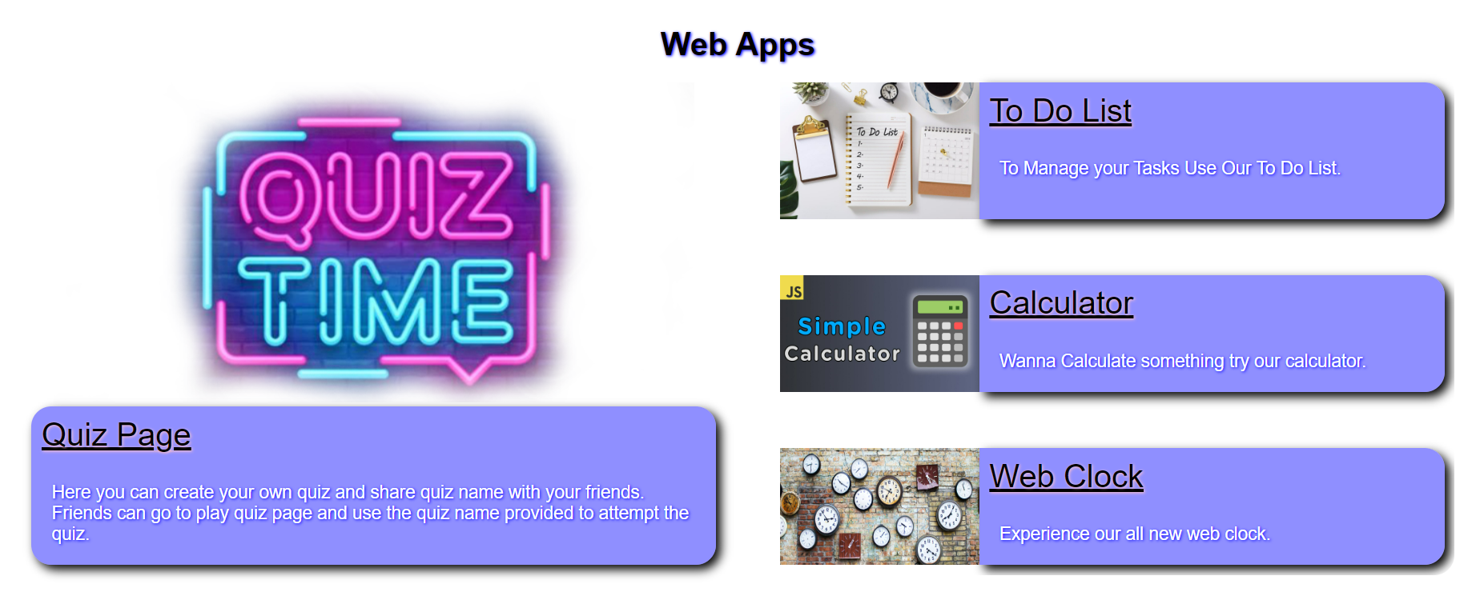
Web Apps

Slide 5
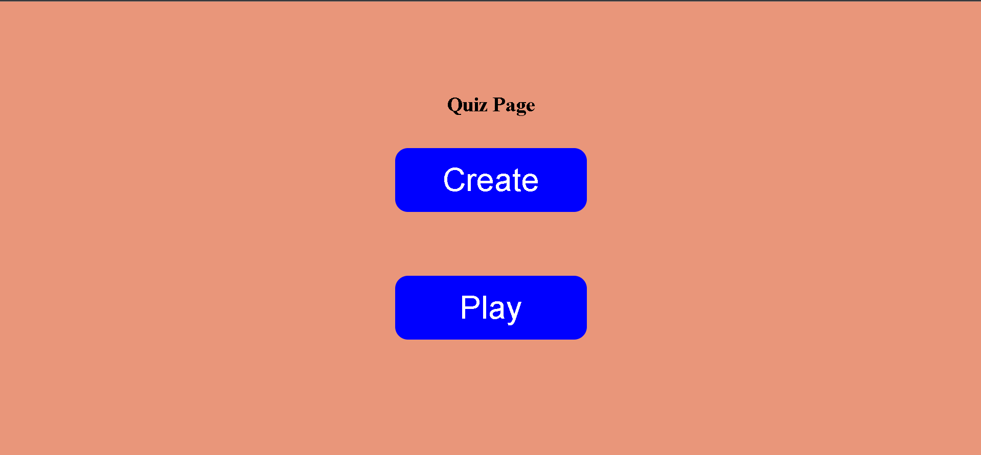
Quiz Page
Here you can create your own quiz and share quiz name with your friends
Live Link->https://anikateagrawal.github.io/WebBootcamp1.0-main/quizapp/index.html

Slide 6
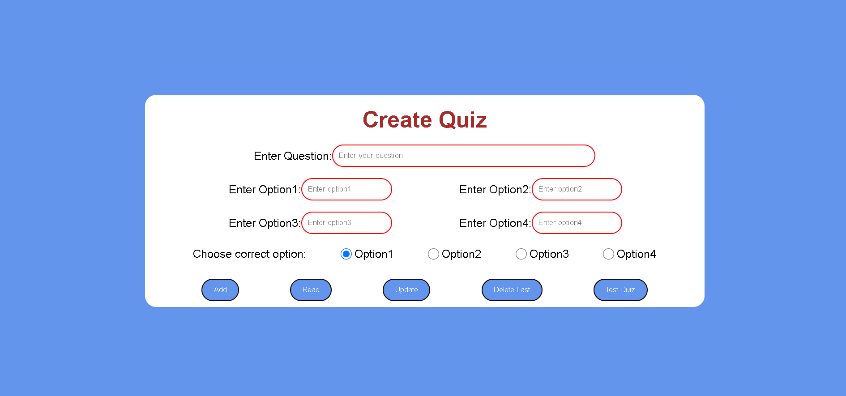
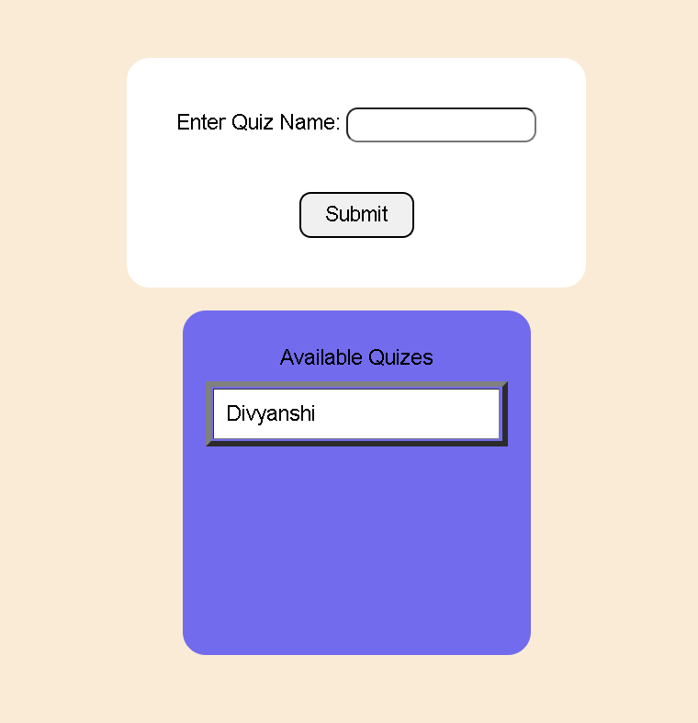

Slide 7

To-Do List
By Using To-Do list you can manage your Tasks easily

Slide 8
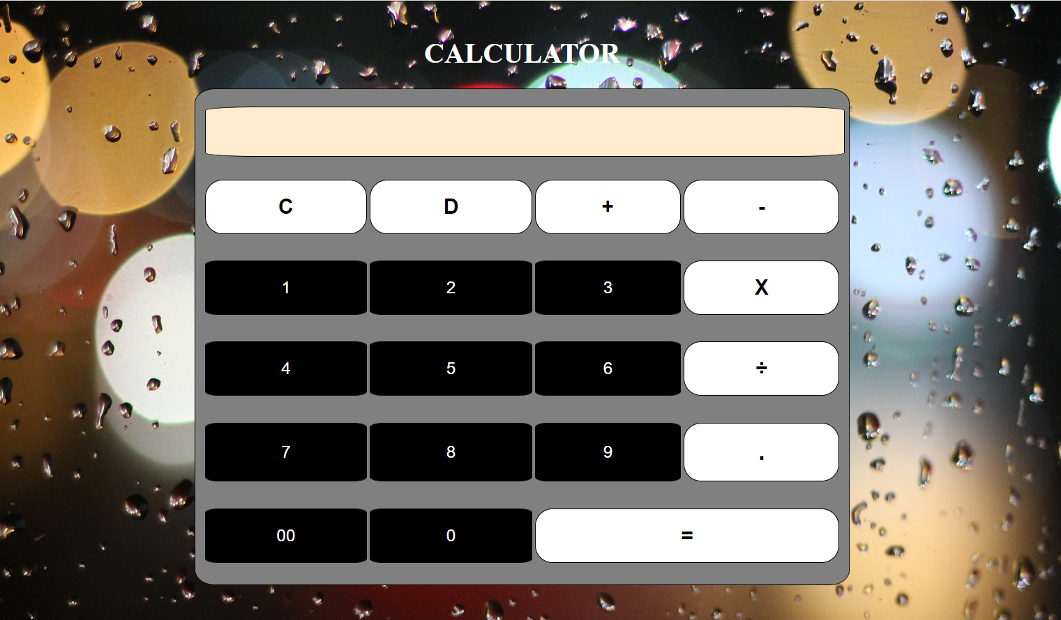
Calculator
You can easily get the answers of the complex problems in just few seconds.

Slide 9

Web Clock
Here you get to know the live time

Slide 10

Web Tech

Slide 11
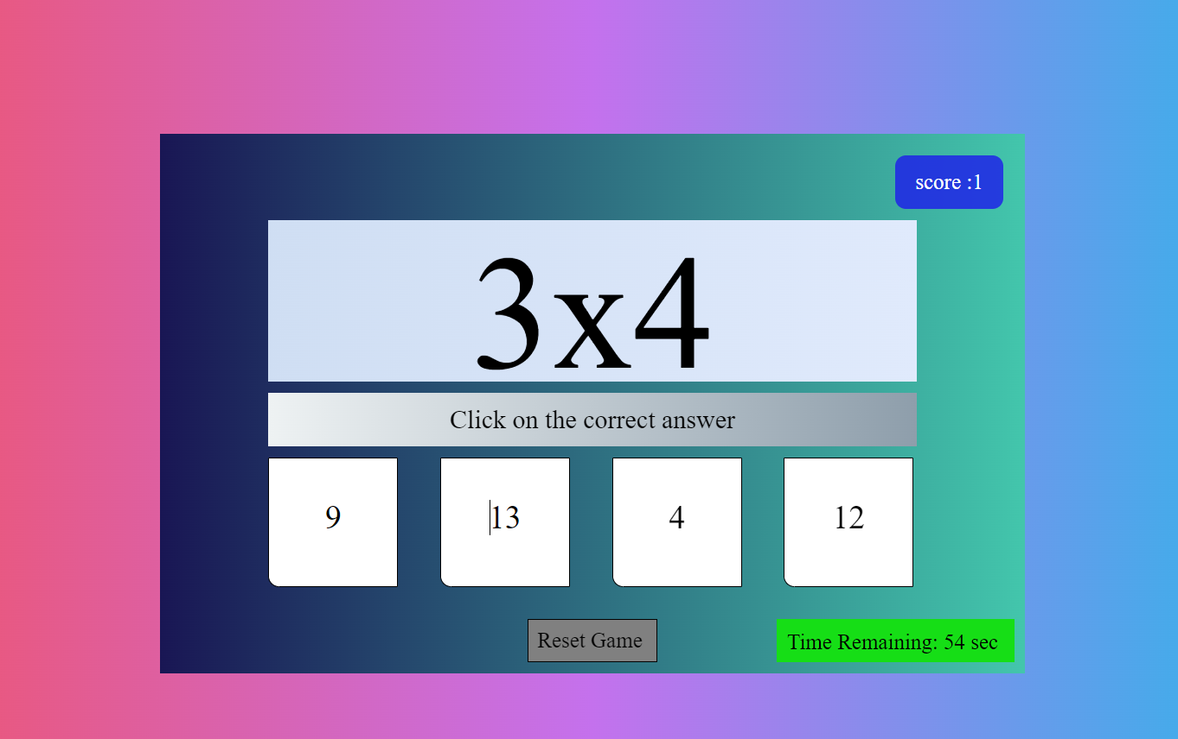
Math Game
Here you can check how good you are in Maths without getting bored.

Slide 12

Track Covid
Here you can find out no. of cases and deaths of covid of any Location.
Live Link->https://anikateagrawal.github.io/WebBootcamp1.0-main/pages/covidapp.html

Slide 13
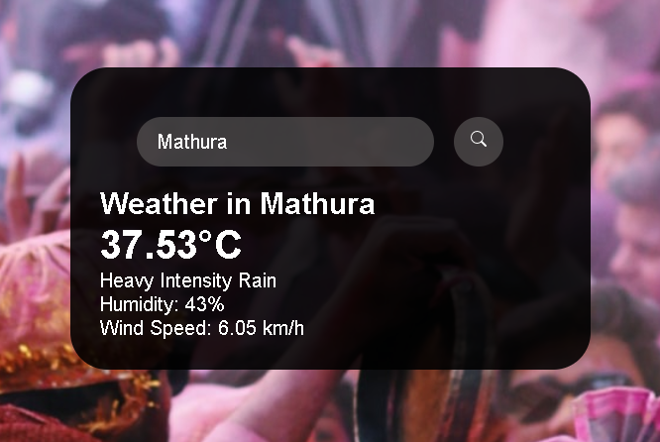
Weather App
Here You can Find out the climate of any place.

Slide 14
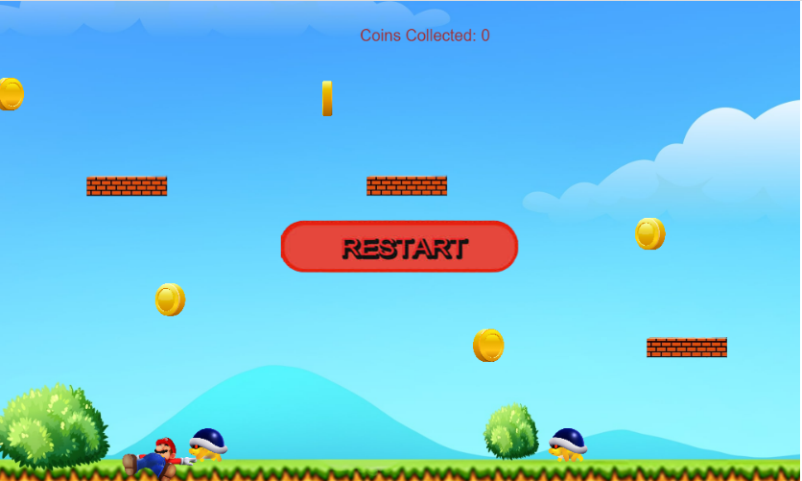
Mario Game
Here your childhood favourite game
Live Link->https://anikateagrawal.github.io/WebBootcamp1.0-main/Mario-Level-1-master/index.html

Slide 15
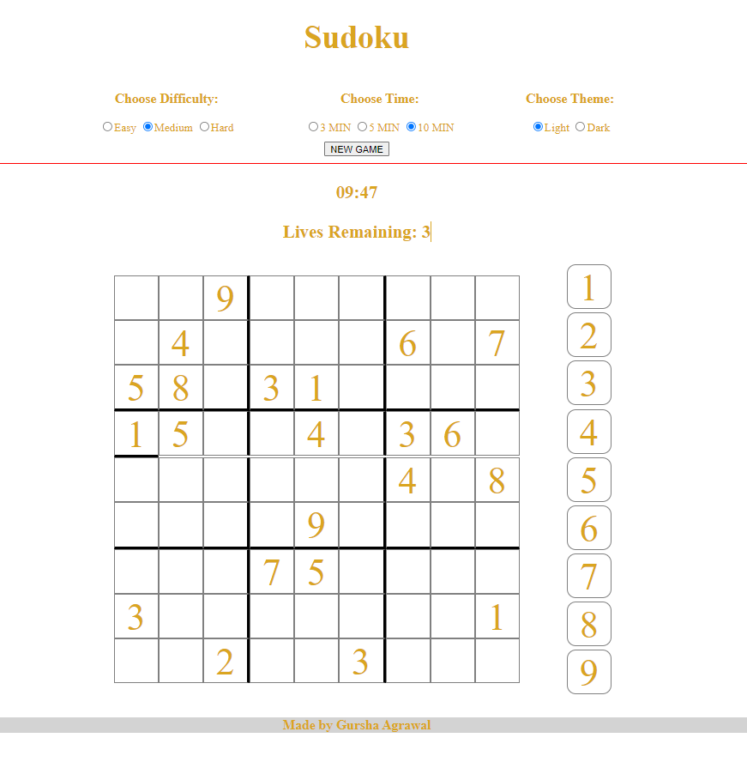
SudoKu
If you are a sudoku lover then get ready to have fun
Live Link->https://gurshaagrawal.github.io/sudoku.github.io/

Slide 16

Gallery
Place of Thousand of memories
Live Link->https://agrawaldisha.github.io/WebDev/html/flexboxphotogallery.html

Slide 17
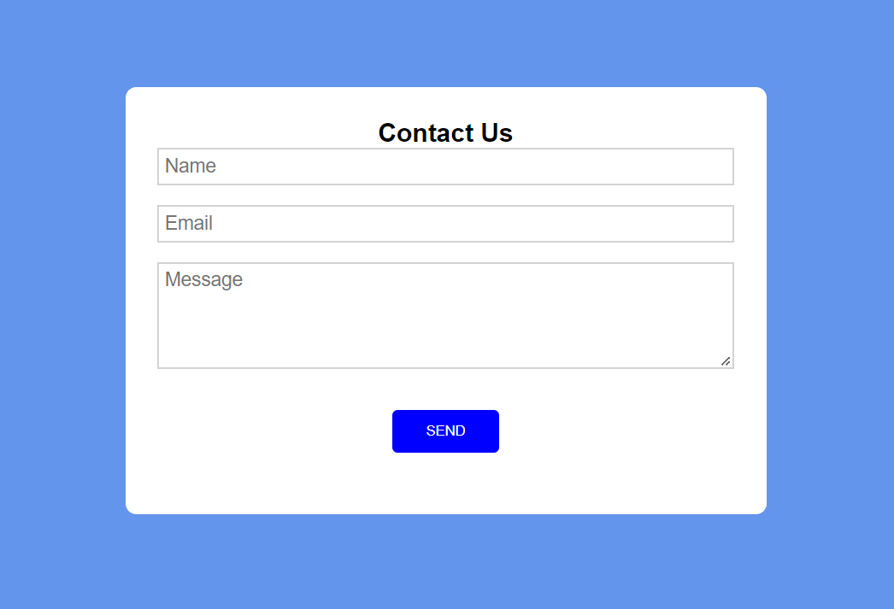
Contact Us
You can send us a message anytime you want.

Slide 18
Thank You
We are ready to receive your valuable feedback.

